Slide 1

Consumer Behavior: Buying, Having, and Being
Twelfth Edition
Chapter 11
Groups and Social Media
Copyright © 2017, 2015, 2013 Pearson Education, Inc. All Rights Reserved.
Notes:
If this PowerPoint presentation contains mathematical equations, you may need to check that your computer has the following installed:
1) MathType Plugin
2) Math Player (free versions available)
3) NVDA Reader (free versions available)
This chapter defines the scope of international business and introduces us to some of its most important topics.

Slide 2
Learning Objectives
11.1 Other people and groups, especially those that possess social power, influence our decisions.
11.2 Word-of-mouth communication is the most important driver of product choice.
11.3 Opinion leaders’ recommendations are more influential than others when we decide what to buy.
11.4 Social media changes the way we learn about and select products

Slide 3

Learning Objective 11.1
Other people and groups, especially those who possess some kind of social power, influence our decisions.
Notes:
This chapter opens with the story of Zachary. Zachary leads a secret life. During the week he is a stock analyst, but on the weekends, he’s out on the road with his Harley-Davidson. Zachary’s group of biker friends is an important part of his identity and this membership influences many buying decisions. The biker group is a reference group. A reference group is an actual or imaginary individual or group conceived of as having significant relevance upon an individual’s evaluations, aspirations, or behavior.

Slide 4

Groups
Social Identity
Minimal group paradigm
Notes:
Social identity theory argues that each of us has several “selves” that relate to groups.
Minimal group paradigm, researchers show that even when they arbitrarily assign subjects to one group or another, people favor those who wind up in the same group.

Slide 5
What Are Sources of Power?
Social power: capacity to alter the actions of others.
Referent power
Information power
Legitimate power
Expert power
Reward power
Coercive power
Notes:
Social power exists when the one person admires the qualities of another and tries to copy the referent’s behavior. It’s important to marketers because consumers voluntarily modify what they do and buy to identify with the referent.
Information power exists when someone knows something others would like to know.
Legitimate power is granted through true authority in a situation. For instance, police officers have legitimate power.
Expert power accrues to a person who is an expert in a particular field. Due to their expertise, others will be influenced by them.
Reward power refers to the influence held by a person who has the ability to offer a reward.
Coercive power is the opposite of reward power. It is held by someone who has the ability to punish.

Slide 6
Membership Versus Aspirational Reference Groups
Membership reference groups
People the consumer actually knows
Advertisers use “ordinary people”
Aspirational reference groups
People the consumer doesn’t know but admire
Advertisers use celebrity spokespeople
Notes:
Membership reference groups are people we know like our families, friendship groups, and colleagues. Because we tend to compare ourselves with similar others, many promotional strategies include ordinary people. Seeing the consumption activities of others acts as a form of social influence. Aspirational reference groups are people we admire. They may be successful businesspeople, athletes, or performers.

Slide 7
Positive Versus Negative Reference Groups
Avoidance groups: motivation to distance oneself from other people/groups
Antibrand communities: coalesce around a celebrity, store, or brand—but in this case they’re united by their disdain for it
Notes:
Reference groups can affect our decisions both positively and negatively. Sometimes we deliberately do the opposite if we want to distance ourselves from avoidance groups.
Antibrand communities are those that coalesce around a brand but they are united by a disdain for the brand. Many brands have been targeted by antibrand communities including Dunkin’ Donuts, Rachael Ray, and Starbucks.

Slide 8
Consumers Do It in Groups
Why do we conform?
Cultural pressure
Fear of deviance
Commitment
Group unanimity
Interpersonal influence
Environmental cues
Notes:
People in larger groups have fewer constraints on behavior. Deindividuation occurs when our individual identities are submerged in the group. In other words, we don’t stay out alone so we may behave differently. At a costume party, we may act wilder than we would in our everyday lives.
The change in our shopping behavior in groups is the reason some brands use home shopping parties.
Why do we tend to conform to the pressure of groups? The primary culprits are listed in the slide. Culture pressure refers to how different cultures encourage conformity to a greater or lesser extent. For instance, the Japanese society emphasizes collective well-being and group loyalty over individuals’ needs.
Individuals may believe that the group will apply sanctions to punish nonconforming behaviors. This is the fear captured in the factor, fear of defiance. According to the principle of least interest, the person who is least committed to staying in a relationship has the most power because that party doesn’t care as much if the other person rejects him. As groups gain in power, compliance increases. The trait, susceptibility to interpersonal influence, refers to an individual’s need to have others think highly of him or her.

Slide 9
Brand Communities and Consumer Tribes
A group of consumers who share a set of social relationships based upon usage or interest in a product
Consumer tribes share emotions, moral beliefs, styles of life, and affiliated product
Brandfests celebrated by community
Notes:
Brandfests are held by many companies like Mini and Harley-Davidson. The festivals enable consumers to interact with others who share a similar brand passion.

Slide 10
For Reflection (1 of 4)
For each type of social power source of influence, share an example of a time you experienced that form of influence.

Slide 11
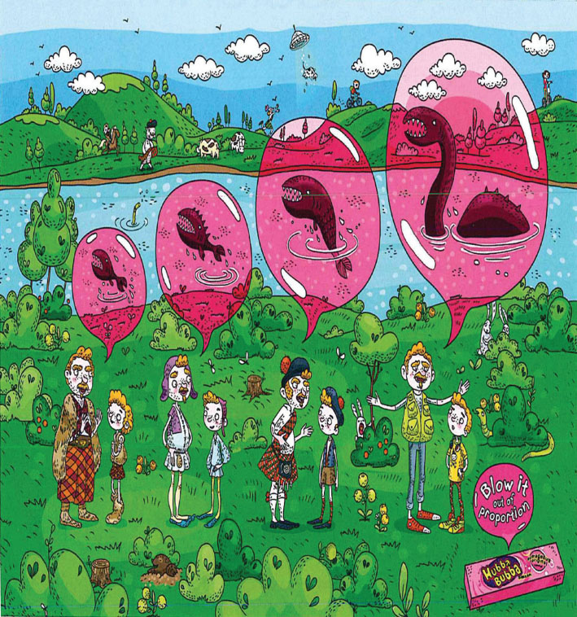
Learning Objective 11.2
Word-of-mouth communication is the most important driver of product choice.

Slide 12
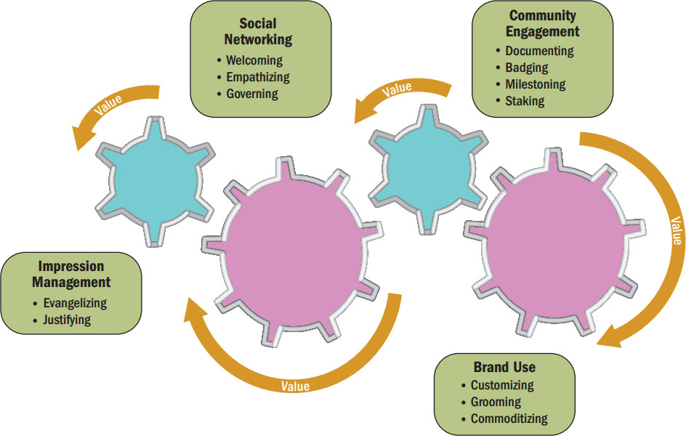
Figure 11.1 Collective Value Creation
Source: Reprinted with permission from Journal of Marketing, “How Brand Community Practices Create Value,” published by the American Marketing Association, Hope Jensen, Albert M. Muniz, and Eric J. Arnould, September 2009, 73, 30–51.
Notes:
In brand communities, experienced members coach newer members. As this process occurs, the community creates added value for being a part of the community. Figure 9.4 illustrates how value is created and socialized throughout the community. Can you apply this process to a community of which you are a part?

Slide 13
Word-of-Mouth Communication
Buzz building
Negative word-of-mouth
Serial reproduction
Notes:
Buzz building is creating “buzz” around some idea, product, or promotion.
Serial reproduction is examining how content mutates

Slide 14
For Reflection (2 of 4)
What organizations or products have you posted negative word-of-mouth about?

Slide 15
Learning Objective 11.3
Opinion leaders’ recommendations are more influential than others when we decide what to buy.
Notes:
This objective deals specifically with organizational decision-making as one of the types of collective decision-making covered in the chapter.

Slide 16

Figure 11.1 The Transmission of Misinformation
Notes:
This figure illustrates how information changes as it is transmitted. The farther from the original source, the more difference exists in the information transmitted. Sometimes this transmission effect creates misinformation about products – especially online.

Slide 17
Opinion Leaders’ Influence
Two-step flow model of influence
Influence network
Information cascades
Notes:
Two-step flow model of influence It proposes that a small group of influencers disseminates information because they can modify the opinions of a large number of other people.
Consumers communicate the information vigorously to one another and they also participate in a two-way dialogue with the opinion leader as part of an influence network.
These conversations create information cascades that occur when a piece of information triggers a sequence of interactions (much like an avalanche).

Slide 18
Characteristics of Opinion Leaders
Experts
Unbiased evaluation
Socially active
Similar to the consumer
Among the first to buy
Notes:
Everyone knows people who are knowledgeable about products and whose advice others take seriously. Opinion leaders are valuable sources of information because they possess social power. They may have expertise but one source of influence is their similarity to the person being influenced. Homophily refers to the degree to which a pair of individuals is similar in terms of education, social status, and beliefs.
The original framework describing opinion leadership is known as the two step flow model of influence. It proposes that a small number of influencers disseminate information because they can modify the opinions of a large number of other people. Research has shown that this might not be the case. Instead, influentials share the information with those who are easily influenced and then those people continue to talk among themselves, resulting in information cascades.
The influence of these opinion leaders is more widespread online. Forrester calls these people Mass Connectors and they are responsible for about 80% of brand mentions online.

Slide 19
The Market Maven
Market mavens are actively involved in transmitting marketplace information of all types
Into shopping and aware of what’s happening in the marketplace
Overall knowledge of how and where to get products
Notes:
People can also be influenced by a special type of opinion leader called the market maven. Researchers use a scale to identify market mavens. The scale includes items like “I like introducing new brands and products to my friends.”

Slide 20
The Surrogate Consumer
Surrogate consumer: a marketing intermediary hired to provide input into purchase decisions.
Interior decorators, stockbrokers, professional shoppers, college consultants
Consumer relinquishes control over decision-making functions
Marketers should not overlook influence of surrogates!
Notes:
Surrogate consumers are opinion leaders we usually pay for advice. Their recommendations are very influential! Some examples include personal shoppers and interior designers.

Slide 21
How Do We Find Opinion Leaders?
The self-designating method
Simply ask individuals whether they consider themselves to be opinion leaders
Easy to apply to large group of potential opinion leaders
Inflation or unawareness of own importance/influence
Key informant method
Key informants identify opinion leaders
Notes:
Companies want to use opinion leaders to spread word-of-mouth communication about their brands, but how do they find the opinion leaders? The most common technique is simply to ask individual consumers whether they consider themselves to be opinion leaders. The problem is that just because we transmit advice about products does not mean that other people take the advice. For someone to be a true opinion leader, others must follow the advice given. Figure 11.2 provides a scale used to identify opinion leaders.

Slide 22
Sociometric Methods
Sociometric methods: trace communication patterns among group members
Systematic map of group interactions
Most precise method of identifying product-information sources, but is very difficult/expensive to implement
Network analysis
Referral behavior/network, tie strength
Bridging function, strength of weak ties
Notes:
The play Six Degrees of Separation is based on the premise that everyone is connected to everyone else, at least indirectly. Sociometric methods trace communication patterns among members of a group. We can use this method to better understand referral behavior and to locate strengths and weaknesses in terms of how one’s reputation flows through a community. Network analysis focuses on communication in social systems, considers the relationships among people in a referral network, and measures the tie strength among them. Tie strength refers to the nature of the bond between people. It can range from strong primary to weak secondary. Even weak ties can be influential.

Slide 23
For Reflection (3 of 4)
What opinion leaders have influenced your purchase behavior?

Slide 24
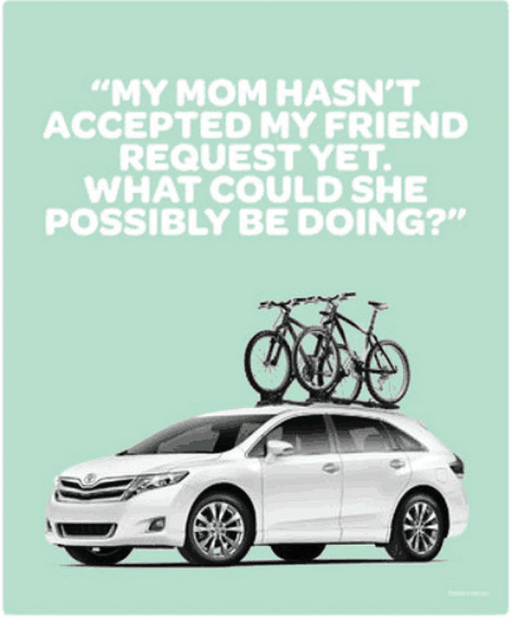
Learning Objective 11.4
Social media changes the way we learn about and select products.
Source: Courtesy of Toyota Motor Sales U.S.A., Inc.

Slide 25
Successful Online Social Networks and Communities
Standards of behavior
Member contributions
Degree of connectedness
Notes:
●● Standards of behavior: Rules that specify what members can and can’t do on the site. Some of these rules are spelled out explicitly (e.g., if you buy an item on eBay, you
agree that you have entered into a legal contract to pay for it), but many of them are unspoken. A simple example is discouragement of the practice of flaming when a POST CONTAINS ALL CAPITAL LETTERS TO EXPRESS ANGER.
●● Member contributions: A healthy proportion of users need to contribute content. If not, the site will fail to offer fresh material and ultimately traffic will slow. Participation
can be a challenge, though. Remember the 80/20 rule we discussed way back in Chapter 1? It applies to online consumption as well. The fact is that most members
of an online community are lurkers. That’s kind of a creepy term, but it just means they absorb content that others post rather than contributing their own. Researchers
estimate that only 1 percent of a typical community’s users regularly participate, and another nine percent do so only intermittently. The remaining 90 percent just observe
what’s on the site. Although they don’t contribute content, they do offer value to advertisers that simply want to reach large numbers of people.
But what happens when we want to engage consumers more actively? How can a site convert lurkers into active users? The easier it is to participate, the more likely it is
that the community can generate activity among a larger proportion of visitors. In part, this means ensuring that there are several ways to participate that vary in ease of use.
Facebook is an example of an online community that has figured out how to offer several forms of participation. Members can post status updates (easy), make comments, upload
pictures, share notes and links, play social games, answer quizzes, decorate their profiles, upload videos, and create events (a bit harder), among other forms of participation.
●● Degree of connectedness: Powerful groups are cohesive; this means the members identify strongly with them and are highly motivated to stay connected. Online groups
may be even more cohesive than physical groups, even though many of the members will never meet one another in person. For example, compared to the “six degrees of
separation” norm we discussed, researchers estimate that Facebook’s members on average have only four degrees of separation from each other. Although some users
have designated only one friend and others have thousands, the median is about 100 friends.

Slide 26
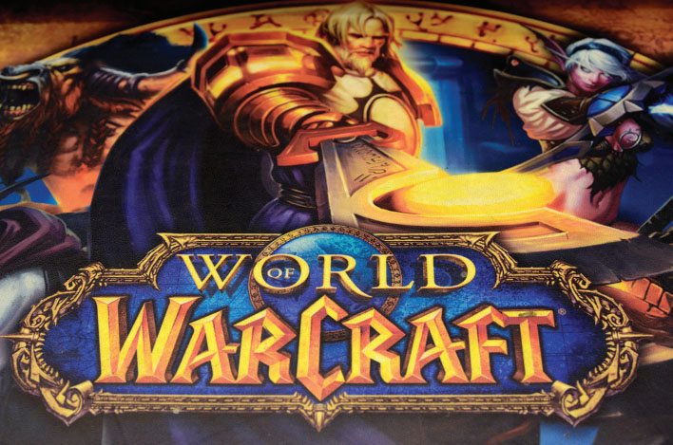
Social Games
Leaderboards
Badges
Game platform
Mode
Milieu
Genre
Notes:
●● A game platform refers to the hardware systems on which the game is played. Platforms include game consoles (consoles are interactive, electronic devices used
to display video games, such as Sony’s PlayStation3, Microsoft’s Xbox 360, and Nintendo’s Wii), computers (including both online games and those that require software
installation on the player’s computer hard drive), and portable devices that may include smartphones or devices specifically for game play such as the Sony PSP or
Nintendo DS.84
●● Mode refers to the way players experience the game world. It includes aspects such as whether a player’s activities are highly structured, whether the game is single-player
or multiplayer, whether the game is played in close physical proximity to other players (or by virtual proximity), and whether the game is real-time or turn-based.
●● Milieu describes the visual nature of the game, such as science fiction, fantasy, horror,
and retro.
●● The genre of a game refers to the method of play. Popular genres include simulation, action, and role-playing. Simulation games depict real-world situations as accurately as
possible. There are several subgenres, including racing simulators, flight simulators, and “Sim” games that enable players to simulate the development of an environment.
Among social games, simulations include the highly popular FarmVille, Pet Resort, and FishVille. Action games consist of two major subgenres: first-person shooters
(FPS), where you “see” the game as your avatar sees it, and third-person games. In role-playing games (RPGs), the players play a character role with the goal of completing
some mission. Perhaps the best-known RPG started its life as a tabletop game: Dungeons and Dragons. Players adopt the identity of a character in the game story and
go about completing tasks and collecting points and items as they strive to accomplish the intended goal.

Slide 27

Digital Word-of-Mouth
Viral marketing
Haul videos
Unboxing videos
Megaphone effect
Disperferred Marker Effect
Notes:
Viral marketing occurs when an organization motivates visitors to forward online content to their friends; the message quickly spreads much like a cold virus moves among residents
of a dorm.
However the urge to share even creates new genres of communication such as haul videos that feature a proud fashionista describing clothing items she just bought, and unboxing videos that illustrate in painstaking detail exactly how to remove electronics products from their boxes and assemble them for use (if you don’t believe it, Google these terms!).
Dispreferred Marker Effect. Online posts that are really negative may make the writer look harsh and judgmental, so people sometimes soften them by couching them
in dispreferred markers, including phrases such as, “I’ll be honest,” “God bless it,” or “I don’t want to be mean, but …” Sure enough, readers of these kinds of posts evaluated
the writer more positively than they did posters who just laid the bad news, warts and all.

Slide 28
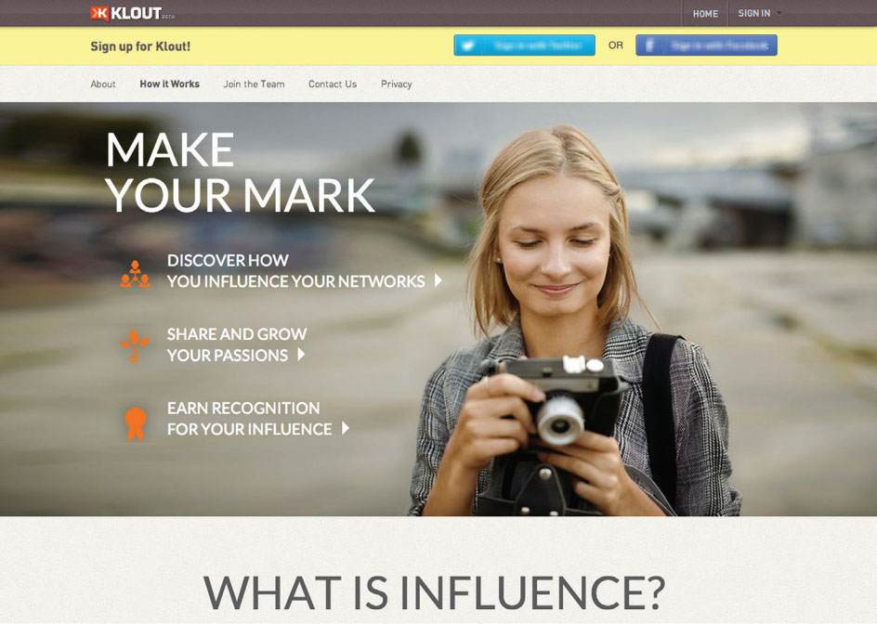
Digital Opinion Leaders
Power users
Influence impressions
Mass connectors
Notes:
Power users have a strong communications network that gives them the ability to affect purchase decisions for a number of other consumers, directly and indirectly.
In advertising lingo, an impression refers to a view or an exposure to an advertising message. Forrester estimates that, each year, U.S. consumers generate 256
billion influence impressions as people talk about their lives with each other, telling stories and experiences that invariably include brands.96 These influence impressions are
primarily delivered by—you guessed it—power users: Only 6.2 percent of social media users are responsible for about 80 percent of these brand mentions. Forrester calls these influencers mass connectors.

Slide 29
For Reflection (4 of 4)
What social games do you play? How have they influenced your purchase behavior?

Slide 30
Chapter Summary (1 of 2)
Other people and groups, especially those that possess social power, influence our decisions.
Word-of-mouth communication is the most important driver of product choice.
Opinion leaders’ recommendations are more influential than others when we decide what to buy.
Social media changes the way we learn about and select products
Notes:
We’ve reviewed many concepts in this chapter. The key points are noted on the slide.

Slide 31

Copyright

